Slide 1
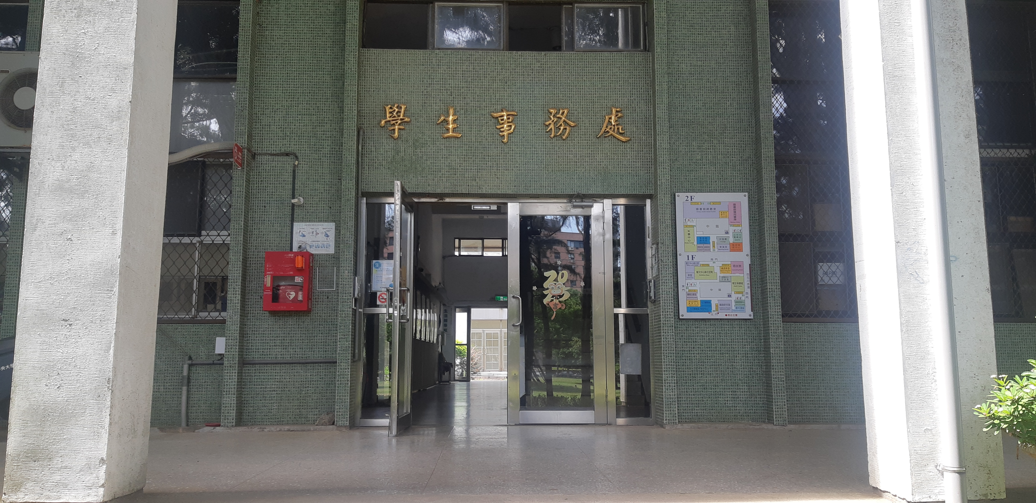
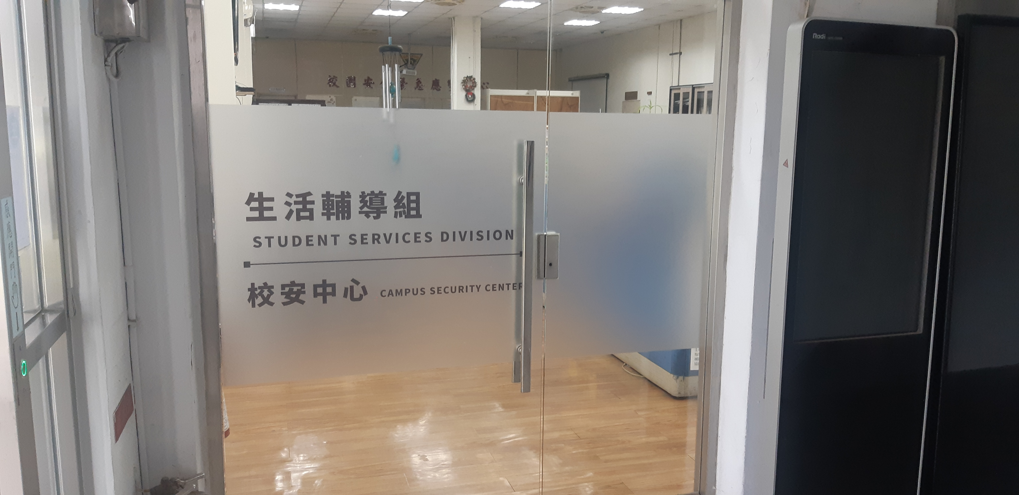
Student Services Division

Slide 2
Student Services Division
Off-campus housing consultation
If you have any rental consultation or dispute, you can
seek assistance from the Student Services Division.
Lost Property Management
If you encounter a lost item, you can go to the Student
Services Division website to check
https://military.ncu.edu.tw/LAF/index.php

Slide 3
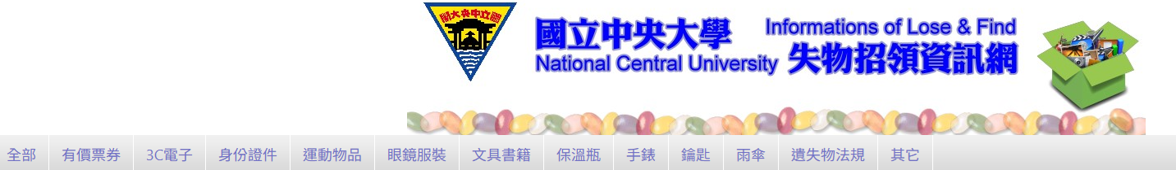

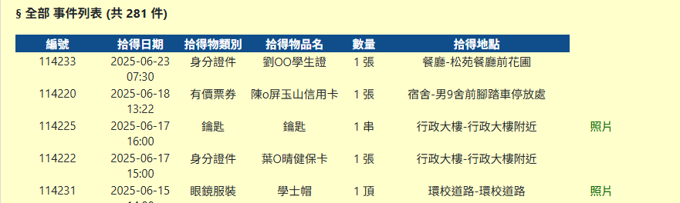
Step1: press options
All
Sports goods
Lost Property Regulations
Other
Ticket of value
ID document
Glasses clothing
Key
3c Electronics
Stationary books
watch
Umbrella
Thermos flask
Step2:press picture

Slide 4
Thank you
24hrs hotline
03-2805666
0911949630

