Slide 1





Gender Equity Education Committee
NATIONAL CENTRAL UNIVERSITY
HTTPS://GENDER.NCU.EDU.TW/

Slide 2


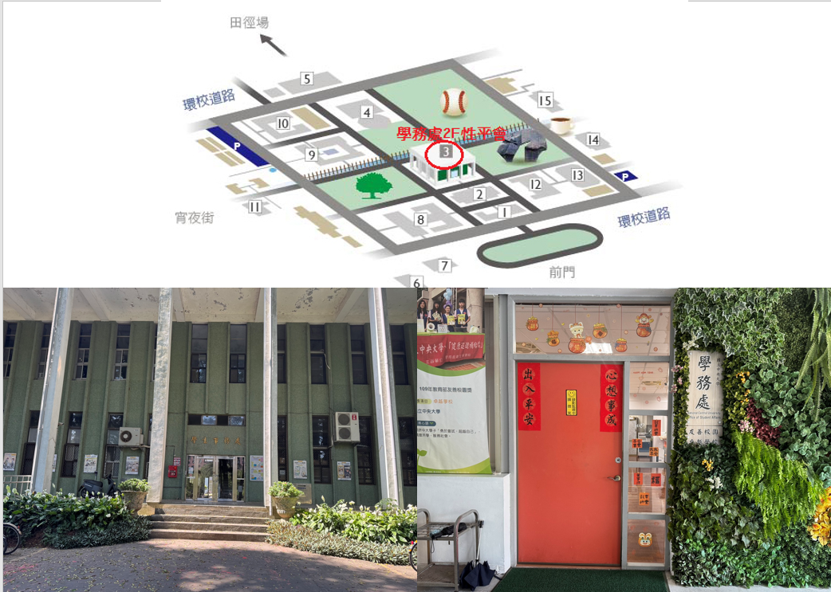
Where is Gender Equity Education Committee ?
  Address： 2F, Office of Student Affairs
  Phone：03-4227151 Ext.57268
  Email：ncu57268@ncu.edu.tw
  Guardroom：03-422-7151Ext.57110、57119
  Emergency Number：
              03-2805666
              0911-949-630
              03-422-7151Ext.57212

Slide 3

Someone told me~ she / he had been harassed, how should I do?
  Please believe his / her words, listen to his / her feelings, and understand what had happened. Let him / her know someone is concerned about him / her.
  Let him / her understand that it was not his / her fault, do not do self-blame, and encouraged him/her that he / she has done their best efforts.
  Give him / her supports and concerns, not questioned him / her: “Why don’t you leave the spot so hurry?", “Why don’t you call for help loudly?", “Why do you wear clothes like that?", “Why do you stay lately there?"… all of the questions only increase the sense of victim’s self-blame and guilt, and self-doubt.
  Respect to his / her feelings and needs, not to act rashly without his / her consent, or take any action to cause Another Hurt. Show your honesty to him / her that no one will talk about the incident to anyone who is irrelevant without his/her consent.
  Tell him/her the assistant resources which he/she can use. If he/she is willing, you can keep company with him / her to assistant agencies or submit his/her appealing paper. In this process, you should keep company with them, support them and let them have opportunities to confront and solve the accident.

Slide 4


Gender Equity Education Act
This Act is prescribed in order to promote substantive gender equality, eliminate gender discrimination, uphold human dignity, and improve and establish the education resources and environment for gender equality.
The definitional scope of a campus sexual harassment incident shall be determined in accordance with the provisions of this Act. In cases where the relationship between the parties involved does not fall within the definitional scope stipulated in this Act, the relevant provisions of the Gender Equality in Employment Act or the Sexual Harassment Prevention Act shall be applied as appropriate to the circumstances.

Slide 5
Reference Information
  The legal age of adulthood in Taiwan is 18.
  Gender Equity Education Act https://law.moj.gov.tw/ENG/LawClass/LawAll.aspx?pcode=H0080067
  Regulations Governing Prevention of Gender-Related Incidents on Campuses
  https://law.moj.gov.tw/ENG/LawClass/LawAll.aspx?pcode=H0080069
  Stalking and Harassment Prevention Act
  https://law.moj.gov.tw/ENG/LawClass/LawAll.aspx?pcode=D0080211
  Sexual Harassment Prevention Act
  https://law.moj.gov.tw/ENG/LawClass/LawAll.aspx?pcode=D0050074
  Gender Equality in Employment Act
  https://law.moj.gov.tw/ENG/LawClass/LawAll.aspx?pcode=N0030014

Slide 6
