Slide 1
About the Counseling Center
Annie Huang

Slide 2

What is individual counseling
The Psychotherapy and Counselling Federation of Australia define professional counselling as:
Professional counselling is a safe and confidential collaboration between qualified psychologists and clients to promote mental health and wellbeing, enhance self-understanding, and resolve identified concerns. Clients are active participants in the counselling process at every stage.
Space of safety and privacy
Counseling Psychologist
Client

Slide 3
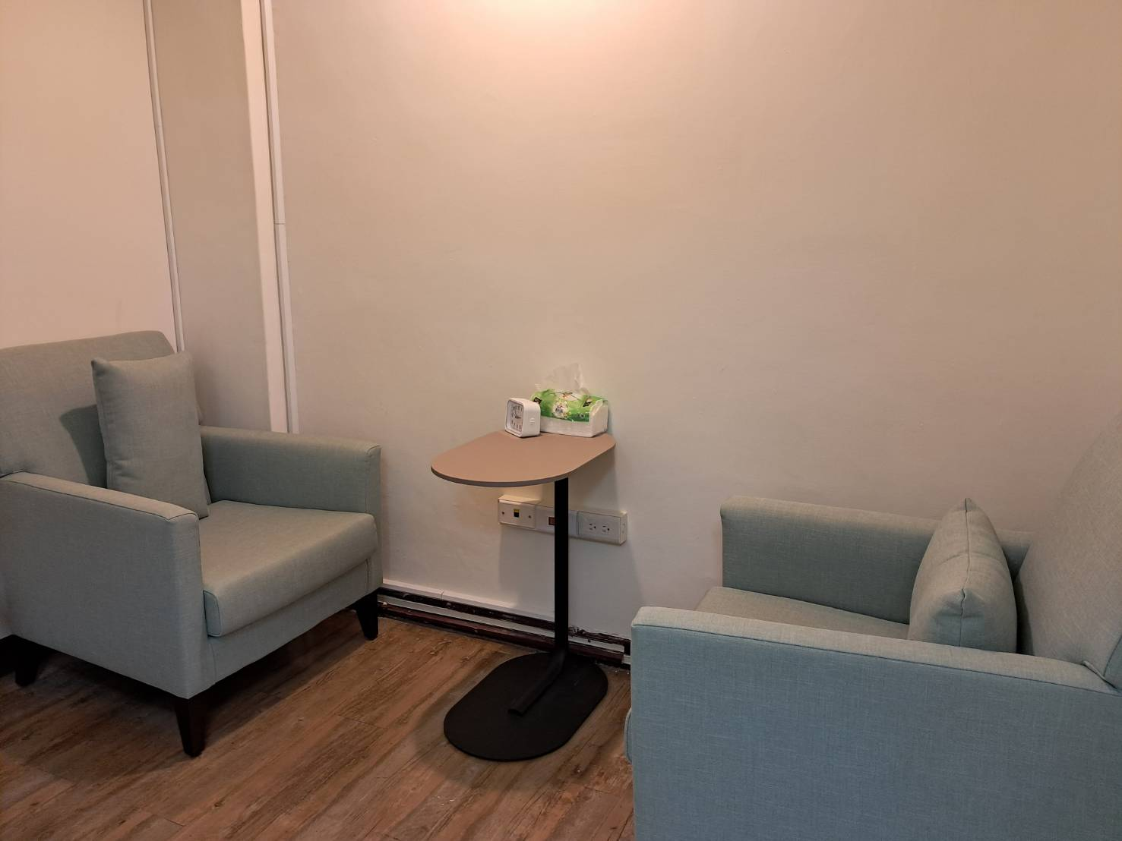
Space of safety and privacy
Confidentiality:
Protecting your privacy
Limits of Confidentiality
to protect you or the public from serious harm
to report domestic violence(intimate violence), abuse or neglect of children, sexual assault, or sexual harassment.

Slide 4

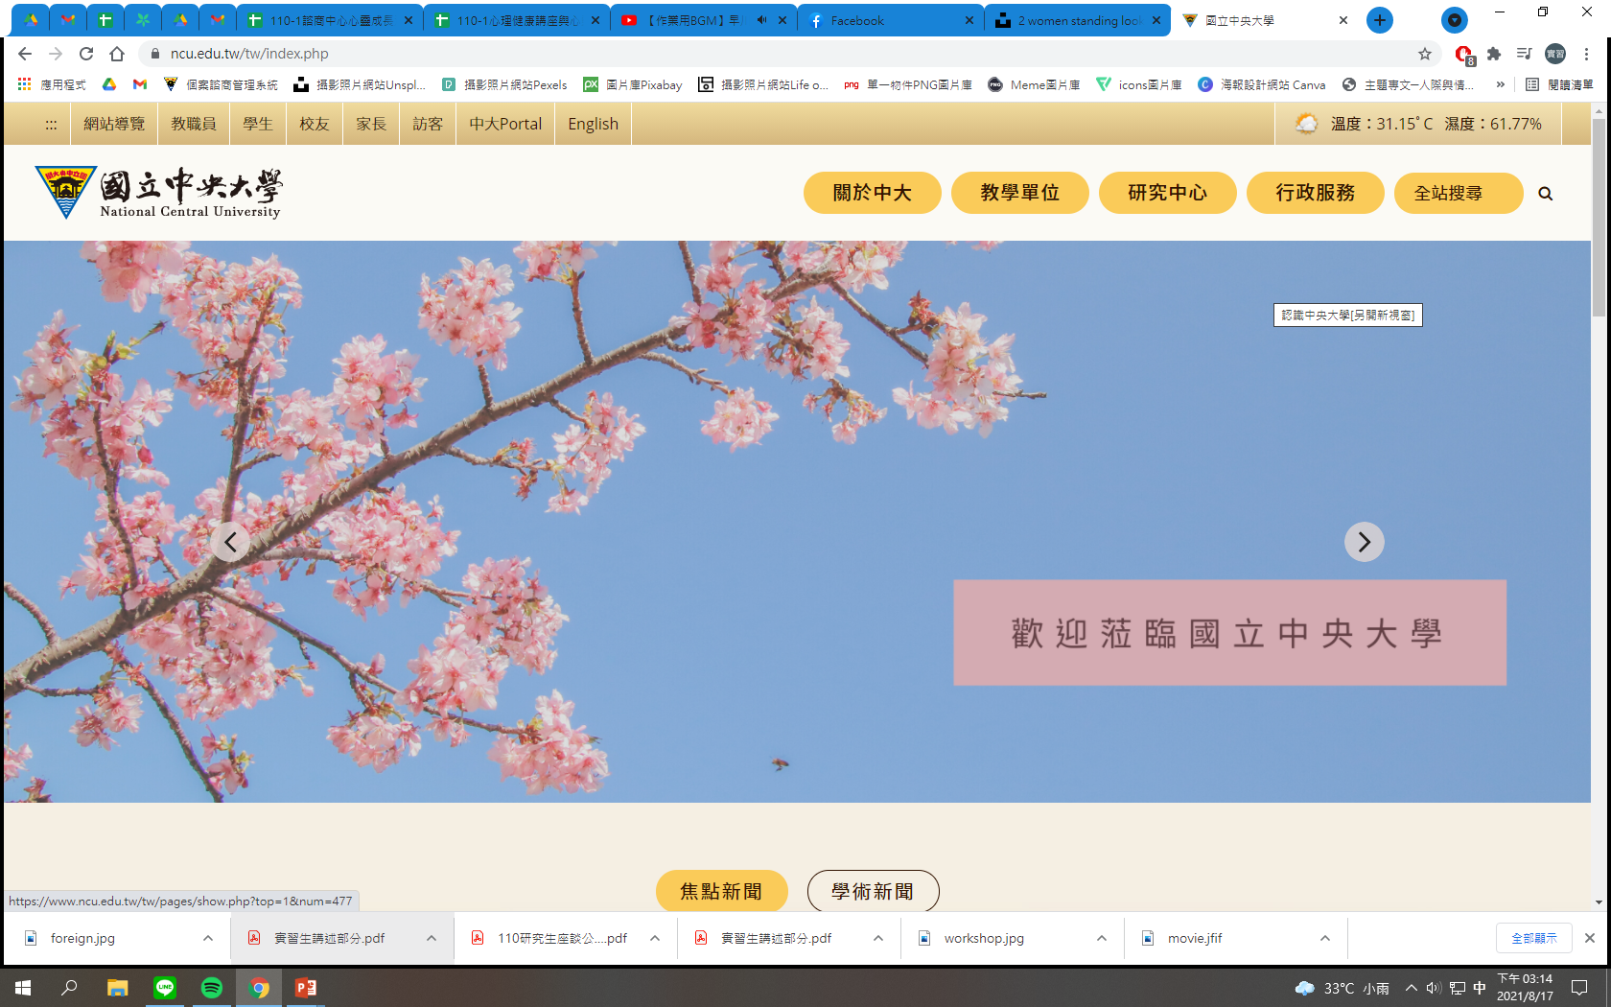
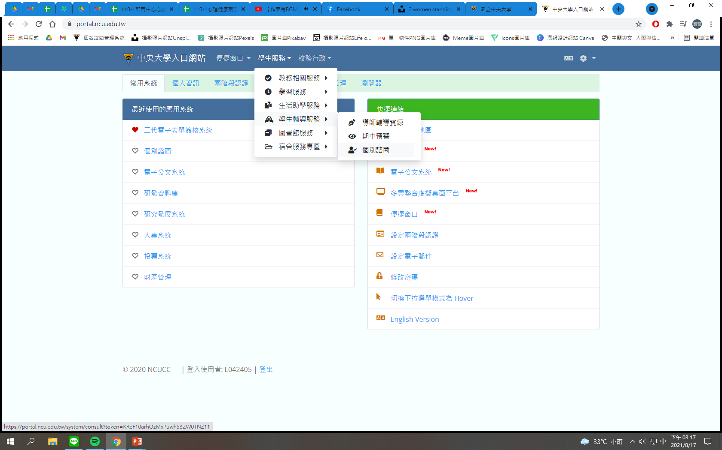

Making an Appointment
Step.1: Press " NCU Portal "
Go to your NCU Portal and click Consult System(個別諮商) to make an appointment.
Schedule your appointment by e-mail. Our email address is ncu7263@cc.ncu.edu.tw
Step.2: Press " Student " , " Student Consulting Service " , " Consult System "

Slide 5

The frame of the counseling
Once a week, and each time takes 50 minutes.
Up to 8 sessions for each semester
With the same counselor

Slide 6
Where is the counseling center

Slide 7
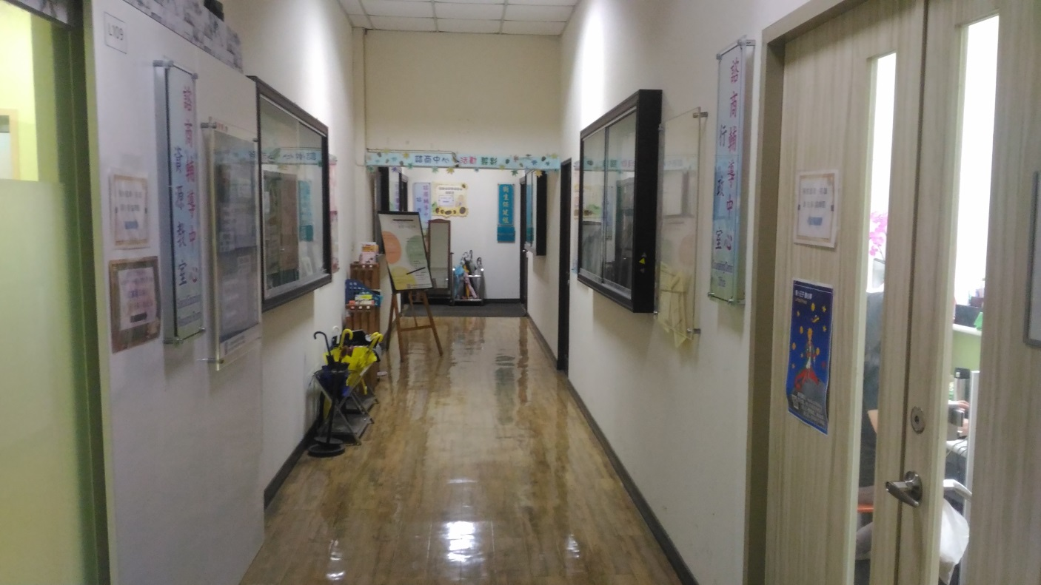
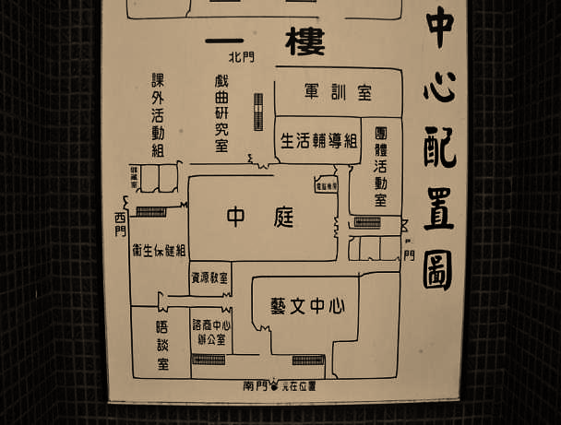
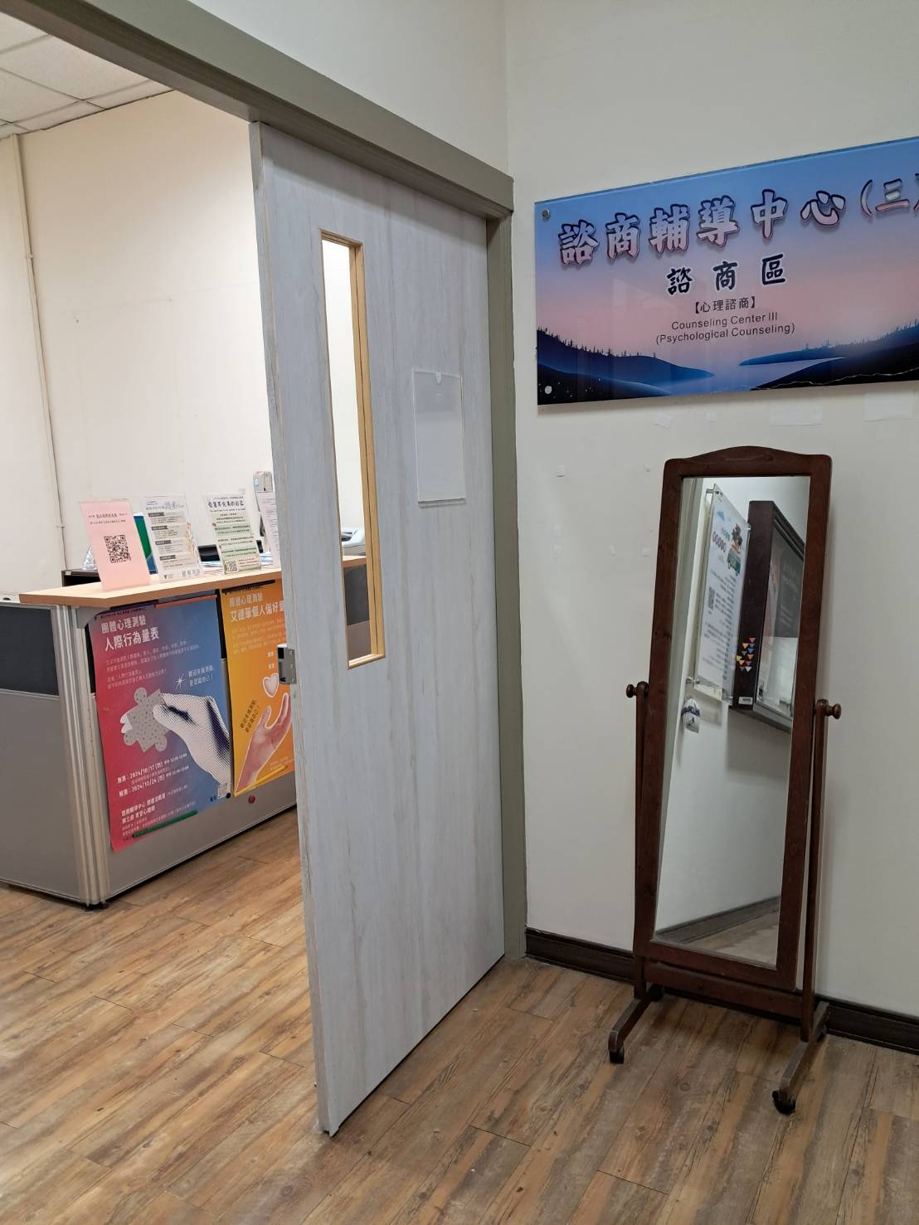
The place of the Counseling Center
Counseling Center
Health Center
Counseling Center is located on your left hand side
Counseling Center
South Gate

Slide 8
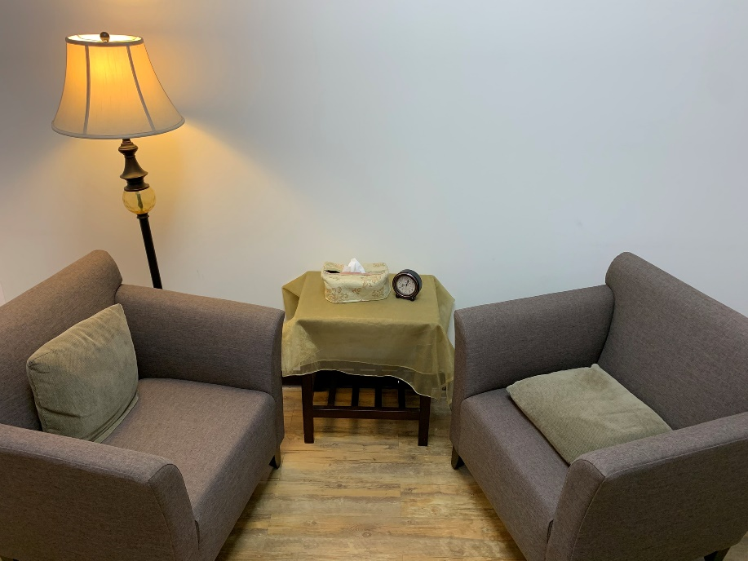
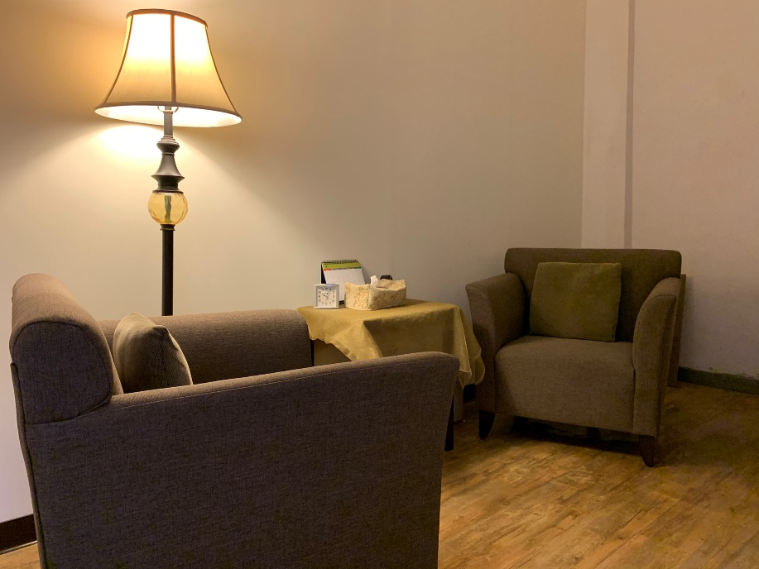
Our Counseling Room

Slide 9

Thank you for your attention!

